Slide 1



Parent and Carer Communication Guide
September 2026

Slide 2

Good communication is essential for us to have fun, feel safe, work together and do our best.
For parents/carers to be part of the team, we all need to communicate well.
In all communication we will be:
kind
courteous
respectful
considerate
Please refer to the Parent Code of Conduct.

Slide 3

What to expect from Five Acre Wood School

Slide 4
You can:
DISCUSS | READ | BROWSE | ACT
meetings – in person or virtual Phone calls Teams chat | emails notes in contact books class updates in Teams | newsletters social media | phone call text website social media
We are always here for you, and we’re very happy to discuss your child’s needs at school. | Read regularly and keep up to date with your child’s progress. | Browse when you can, like it and share our stories. | We know people are busy and alerts are intrusive, but sometimes we just need to reach you quickly.

Slide 5
DISCUSS
meetings – face-to-face or virtual
phone calls
emails
Teams chat
We are always here for you, and we’re very happy to discuss your child’s needs, either in person or over the phone or Teams. Or sometimes an email is enough. And you will have regular conversations at annual reviews too.
Our priority during the day is to teach and support our pupils, so we won’t always be able to answer you straight away. We aim to answer emails and Teams messages within two working days.
If you need to speak to us urgently, please call reception who will direct your enquiry to the right person.

Slide 6
READ
emails
notes in contact books
class update in Teams
This is how we will let you know what your child has been enjoying and learning.
Read the updates regularly and keep up to date with your child’s activities.
We will give as much information as we can, but remember our first priority is to help your child get the most from their day in school.

Slide 7

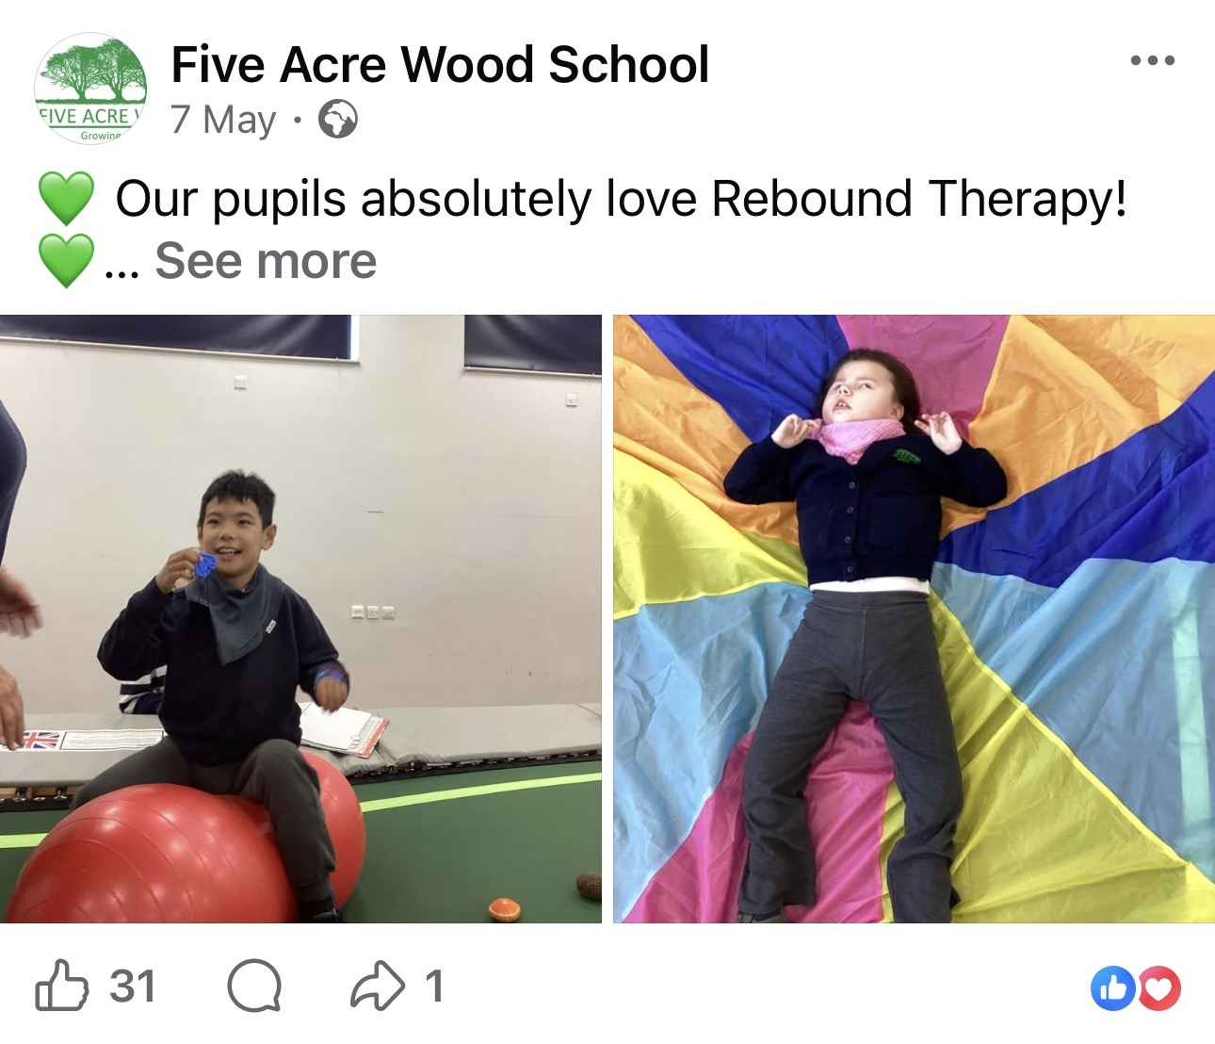
BROWSE
newsletters
social media
We know you like to hear news from the School and what your child has achieved. And it's always good to share our stories with friends and family.
We will email you with updates, and send regular newsletters. We hope you enjoy them!

Slide 8
ACT
phone call
text
website
social media
We know people are busy and alerts are intrusive, but sometimes we just need to reach you quickly regarding your child specifically. On these rare occasions, we will call or send a text or an Arbor app alert, and we’ll need you to act immediately.
For other important incidents, such as closures or traffic issues, we will send a text, app alert or add information to the website and social media, so please keep an eye out.

Slide 9
How you will receive information
CHANNEL | DAILY | WEEKLY | TERMLY | WHEN NEEDED
Notes in contact book
Updates on Microsoft Teams
Newsletters via email
Website and social media
Email, phone call or text
Annual review (three per year)
Your class teacher will inform you how they will communicate with you daily and weekly. This may differ for each class.

Slide 10
How to contact us
HOW URGENT IS IT? | EXAMPLE | HOW TO CONTACT US | HOW WE WILL RESPOND
It’s an urgent issue to be discussed now | My child has a problem today | Phone reception and your enquiry will be passed on to the relevant person | We will deal with your call straight away
I’d like to speak to someone this week | My child needs some help this week | Message your child’s teacher in Microsoft Teams, or Phone reception and leave a message, or Email your child’s teacher | We will answer your query within two working days
I’d like to speak to someone this month | I’d like to discuss my child’s progress | Message your child’s teacher in Microsoft Teams, or Email your child’s teacher | We will answer you within two working days and set up a time to discuss
I’d like to see what’s going on at FAW School | What fun activities has my child been doing? | No need to contact us, you can read the daily and weekly updates, the monthly newsletters and social media

Slide 11
Contact details
Loose site | Boughton Lane Maidstone Kent ME15 9QF Telephone: 01622 743925 Email: office@five-acre.kent.sch.uk
Snodland site | The Wolfe Building Malling Road Snodland Kent ME6 5HS Telephone: 01634 566890
Oxford Road site | Oxford Road Maidstone Kent ME15 8AW Telephone: 01622 392205

