Slide 1
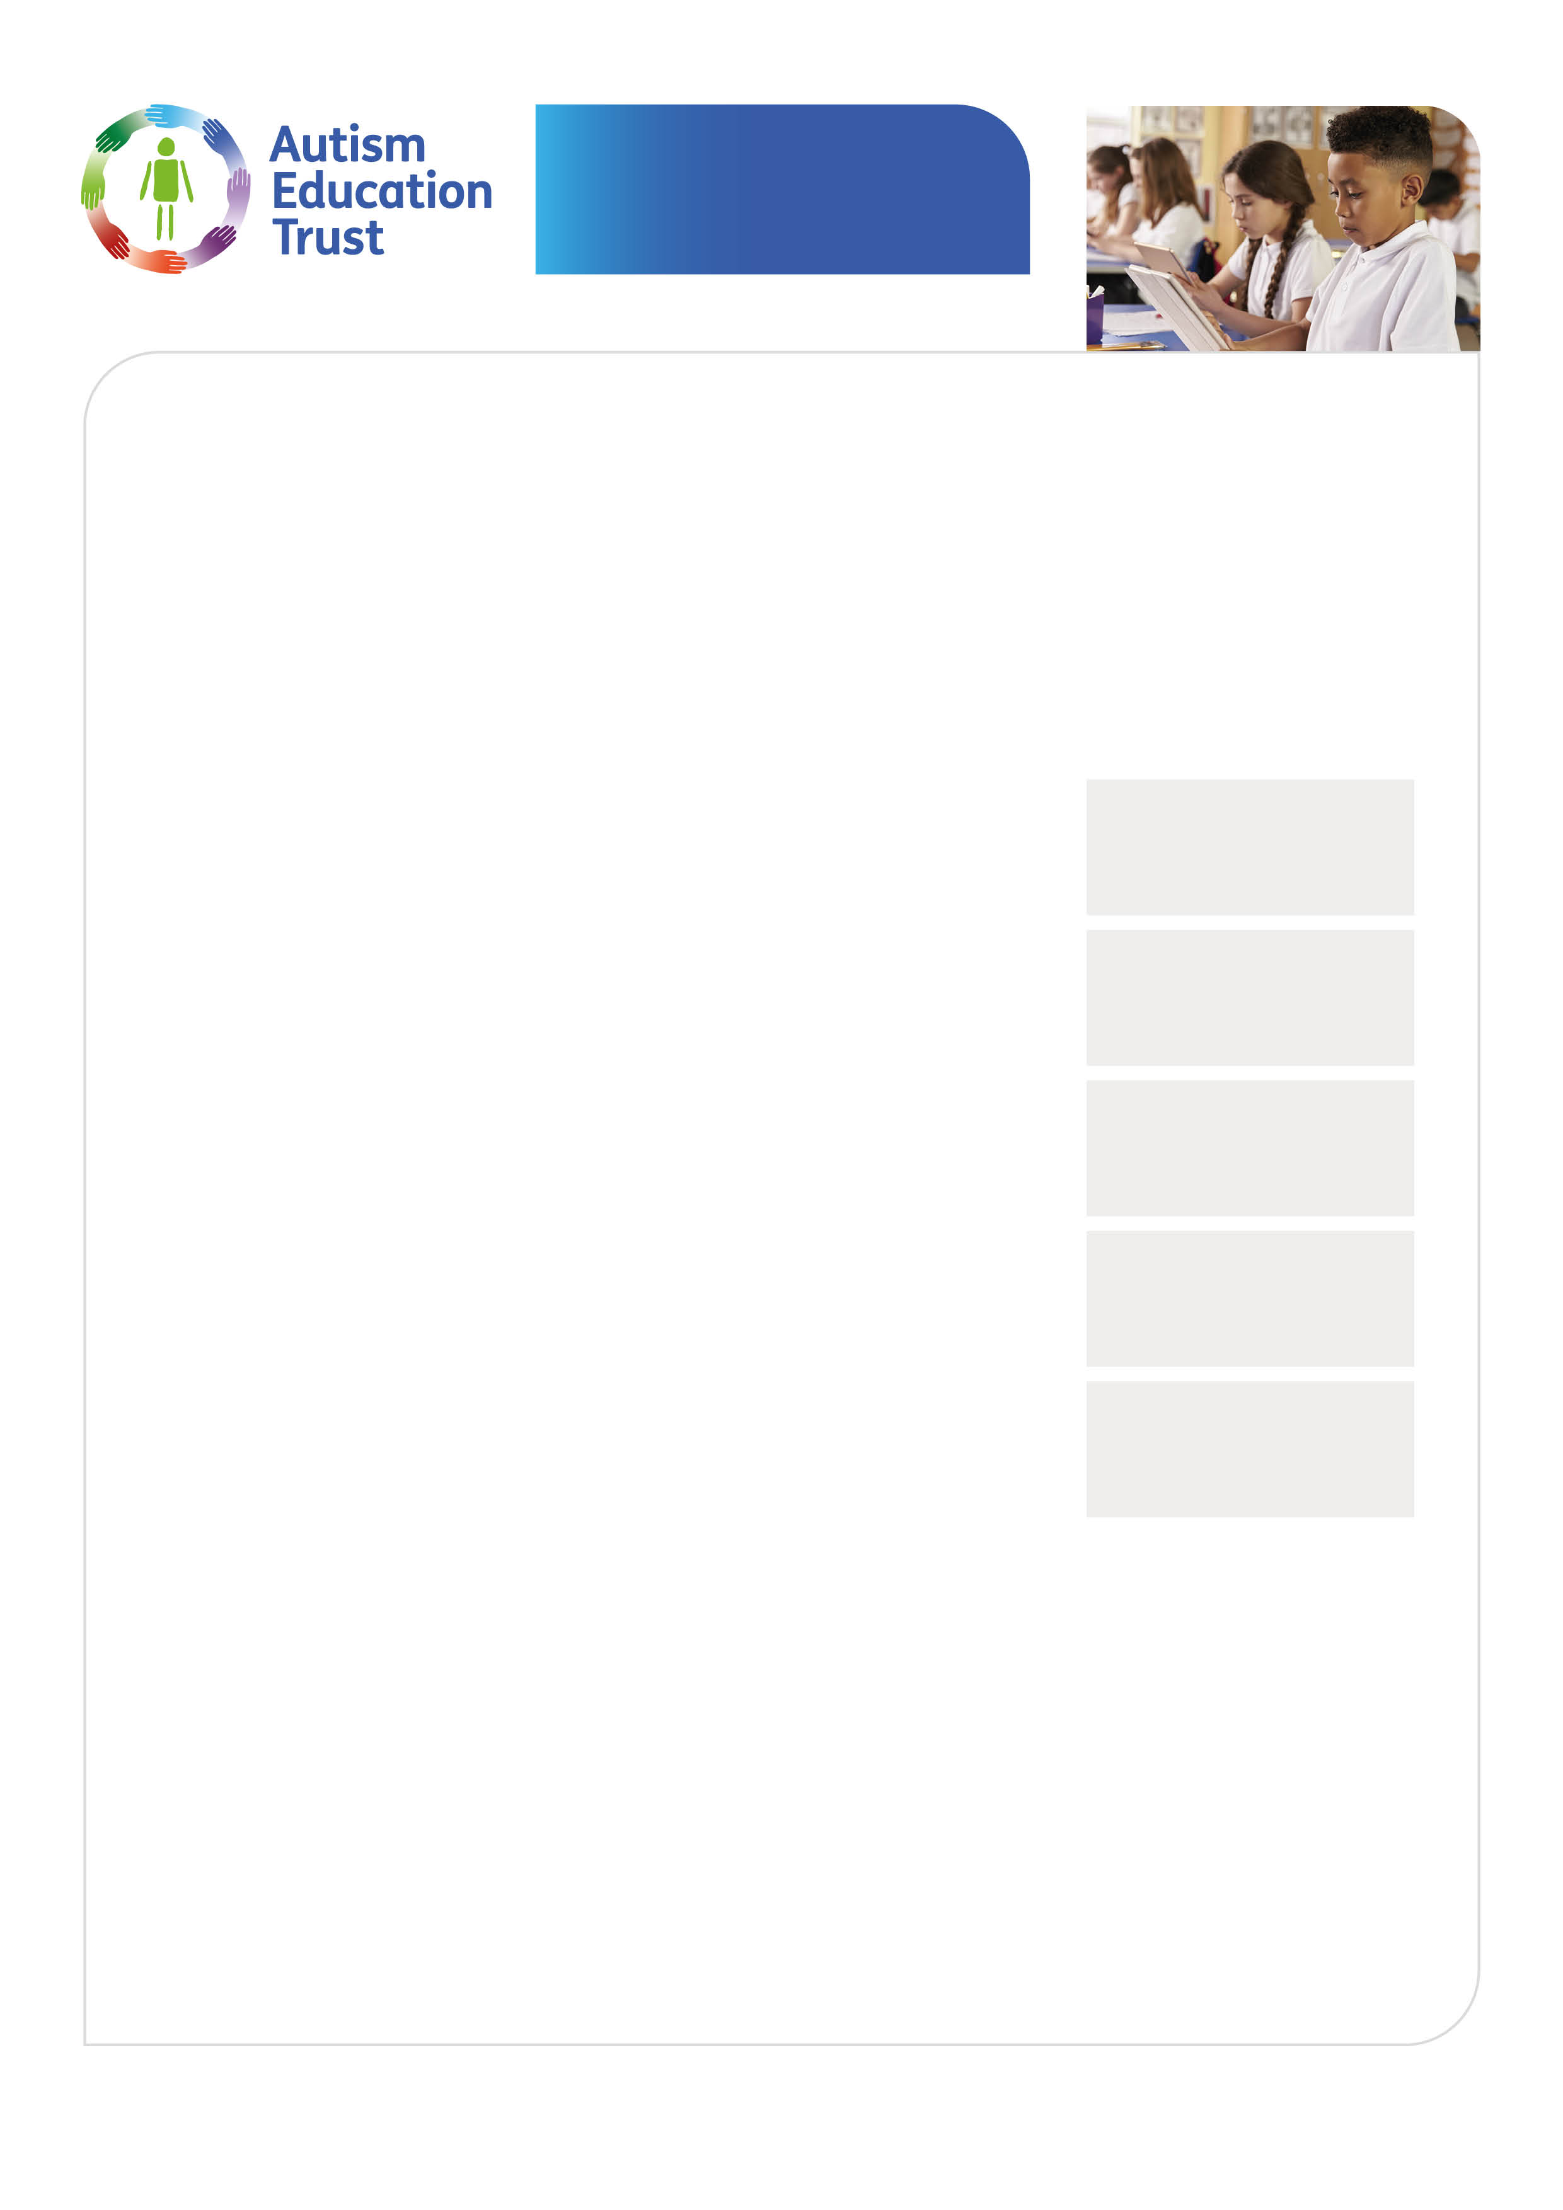
Schools
Good Autism Practice
Gain practical knowledge, and discover hands-on
tools and techniques to support autistic children
in your school.
This module is part of the AET schools’ development programme and links to the schools’ framework documents. These should be referred to and used to as a school and self evaluation tool.
www.autismeducationtrust.org.uk/framework-documents
Developed by
leading autism
specialists
Who is this training for?
This is a module for practitioners who work directly with
autistic children in schools, and it provides guidance on
processes and tools that can help practitioners to implement
good autism practice.
Up to date
with the latest
research
What will you learn?
• Develop your knowledge and understanding
of good autism practice
• Reflect on and improve your practice in working
with autistic pupils
• Understand strategies and approaches you can
draw upon for autistic pupils you work with
• Reflect on the kind of information you need to collect
for creating a person-centred education plan
• Consider how to involve the autistic pupils and their
family in setting learning goals
Enhances
your CPD
Free resources
and frameworks
linked to Ofsted
Optional
certification
School staff should have had AET Making Sense of Autism training, or have considerable experience working with autistic children before booking on this training
Cost £40 per person
Date Thursday 6 June 2024
Time 9.30 – 12.30
Venue STLS Training House
Broomhill Bank School, Broomhill Road, Rusthall, Tunbridge Wells TN3 0TB
To book a place please email Julie.goodfellow@stlsoutreach.org.uk
For more information and free resources visit:
www.austismeducationtrust.org.uk

